Slide 1
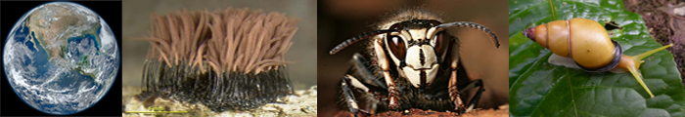
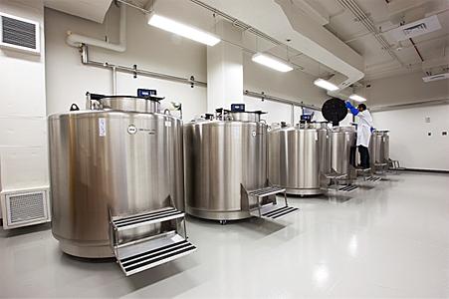
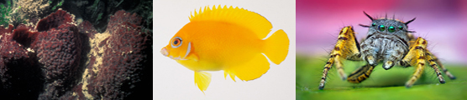
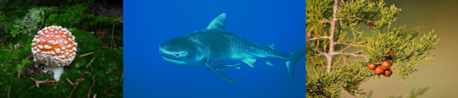
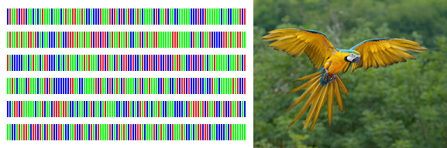
Intro to Biotech
Lect.15
Genomics
Sequence - how do we use info?
Sequencing capability
Storage
Preserve Genomic Diversity of Life on Earth

Slide 2
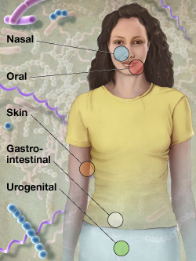
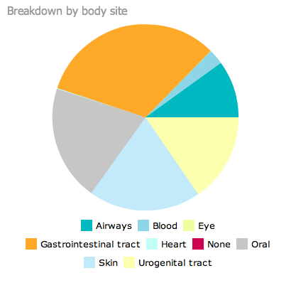
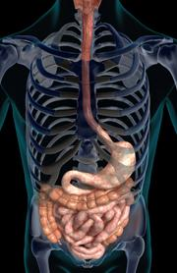
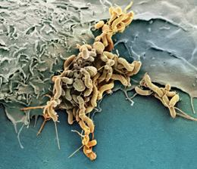
Intro to Biotech
Genomics
Lect.15
Metagenomics
Human microbiome
Goal =
Joshua Lederberg
•
• 4.4lbs
•
• 12,000 samples
MyMicrobes
Enterotypes
• Bacteroides
• Prevotella
• Ruminococcus
Navel:

Slide 3
Intro to Biotech
Synthetic Biology
Lect.16
Synthetic Biology: What is it?
2 broad classes
2.
Biology
Synthetic Biology 1.0 – MIT, 2004
2.
3.

Slide 4
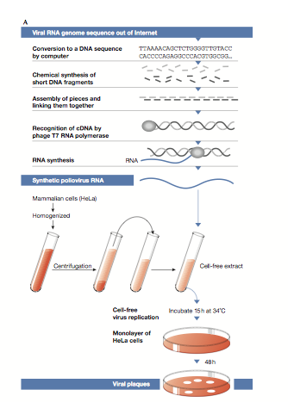
Intro to Biotech.
Synthetic Biology
Lect.16
Synthetic Biology
2002 – Poliovirus
(7.5kb) web…
2003 – PhiX 174
(5kb)
2005 – Spanish flu
CDC, 50million
2008 – Mycoplasma
(582kb)

Slide 5
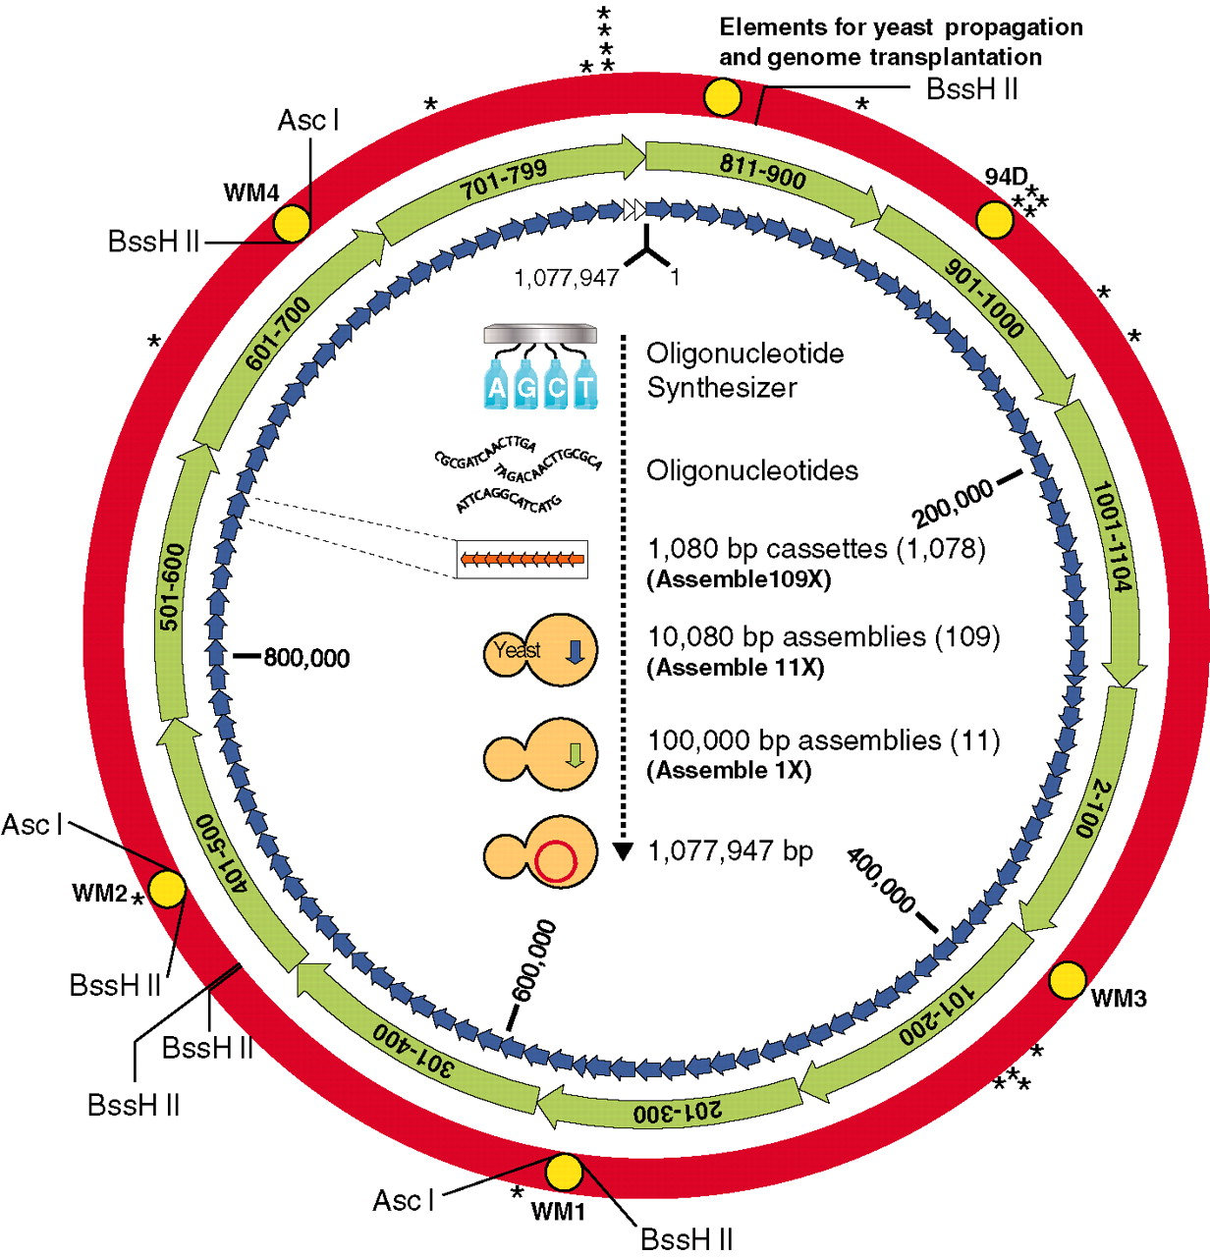
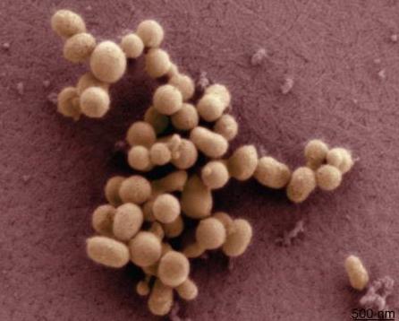
Intro to Biotech
Synthetic Biology
Lect.16
Synthetic genomes
1mb genome:
Mycoplasma mycoides
Mycoplasma capricolum

Slide 6
Intro to Biotech
Synthetic Biology
Lect.16
Synthetic Biology: What is it?
2 broad classes
1.
2.
Biology
Synthetic Biology
Energy
Environment
Medicine
Agriculture
Biosensing

Slide 7
Intro to Biotech
Synthetic Biology
Lect.16
Synthetic Biology
Biology
Synthetic Biology
Recombinant
DNA
Computational
modeling
Sequencing
Synthesis
High throughput
technologies

Slide 8
Intro to Biotech
Synthetic Biology
Lect.16
Synthetic Biology: What is it?
2 broad classes
1. creation of non-natural biological systems
2. redesign of existing biological systems
Biology
Synthetic Biology

Slide 9
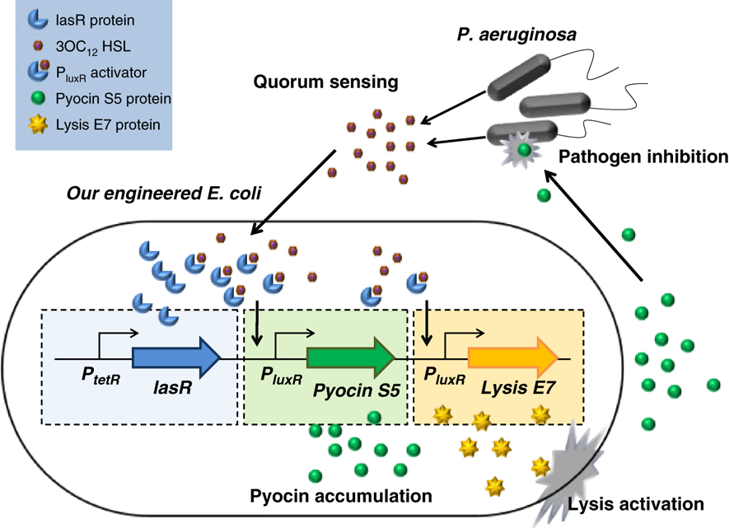
Intro to Biotech
Synthetic Biology
Lect.16
Medicine
Pseudomonas aeruginosa: pathogen
•
007 E. coli: Licensed to kill
1. Sensing system: detect pathogen
What is molecule?
What is detection limit?
2. Antimicrobial system:
3. Killing system:
Transcriptional regulation: What do we need?
•
•

Slide 10
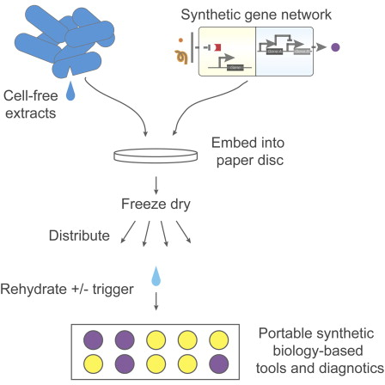
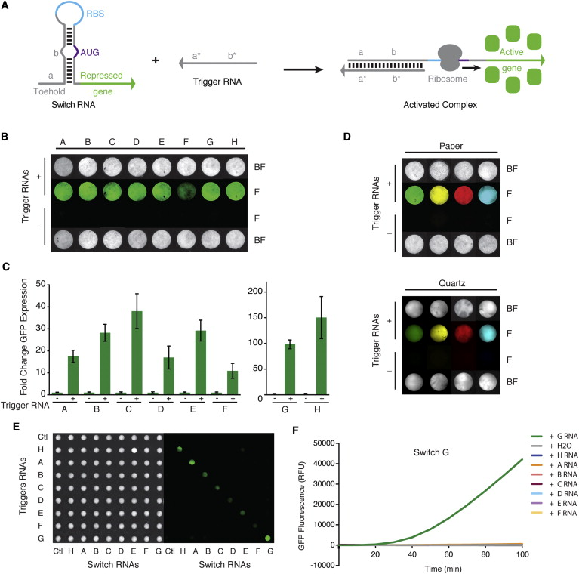
Intro to Biotech
Synthetic Biology
Lect.16
BioSensing
Why – current issues???
What is Signal?
Translation regulation:
What do we need?
•
•
•
•

Slide 11
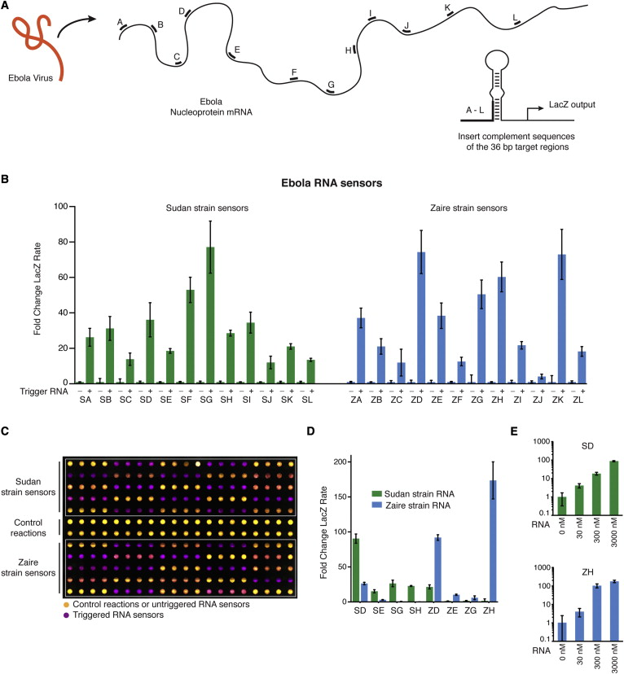
Intro to Biotech
Synthetic Biology
Lect.16
BioSensing
Why – current issues???
What is Signal?

Slide 12
Intro to Biotech
Synthetic Biology
Lect.16
International Genetically Engineered Machine
(iGEM) competition
http://parts.igem.org/Catalog
BioBricks Foundation
- Use standard biological parts to program organisms
- Registry of standard biological parts (17,000)
1. promoters
2. protein coding sequences
3. protein domains
4. plasmids
5. primers
6. etc…
Receivers/Senders
2. Reporters
3. Measurement devices
4. etc…
Biosynthesis
2. Cell signaling
3. Chemotaxis
4. etc…

Slide 13
Intro to Biotech
Synthetic Biology
Lect.16
International Genetically Engineered Machine
(iGEM) competition
BioBricks kit –
Synthetic Biology
Organismal evolution
unknown
Accidental release
Bioweapons

Slide 14
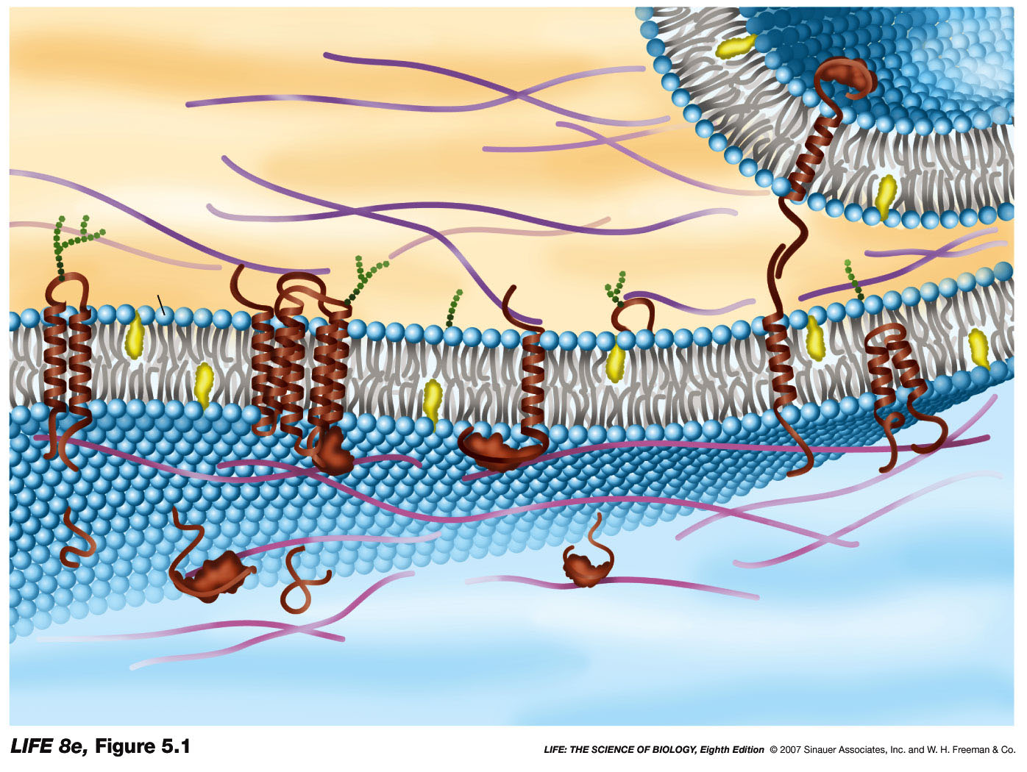
Intro to Biotech
Lect.16
Cell signaling/communication
1. Recognition/Adhesion:
homo vs heterotypic
2. Signaling:
Outside of cell
1.
2.
3.
4.
Inside of cell

Slide 15
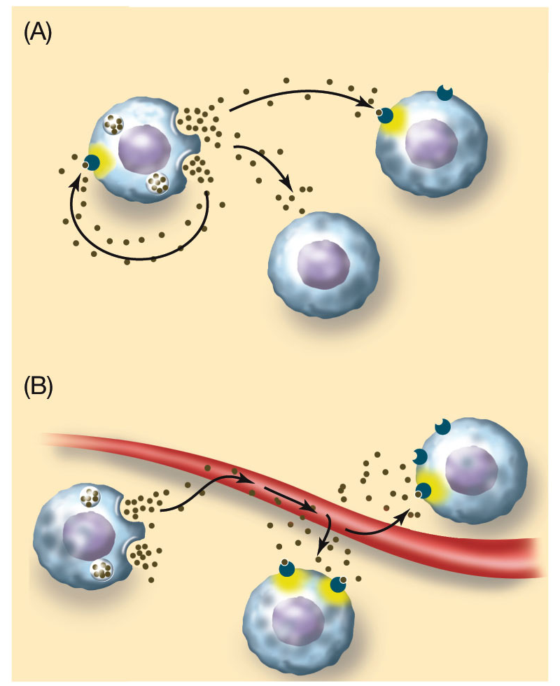
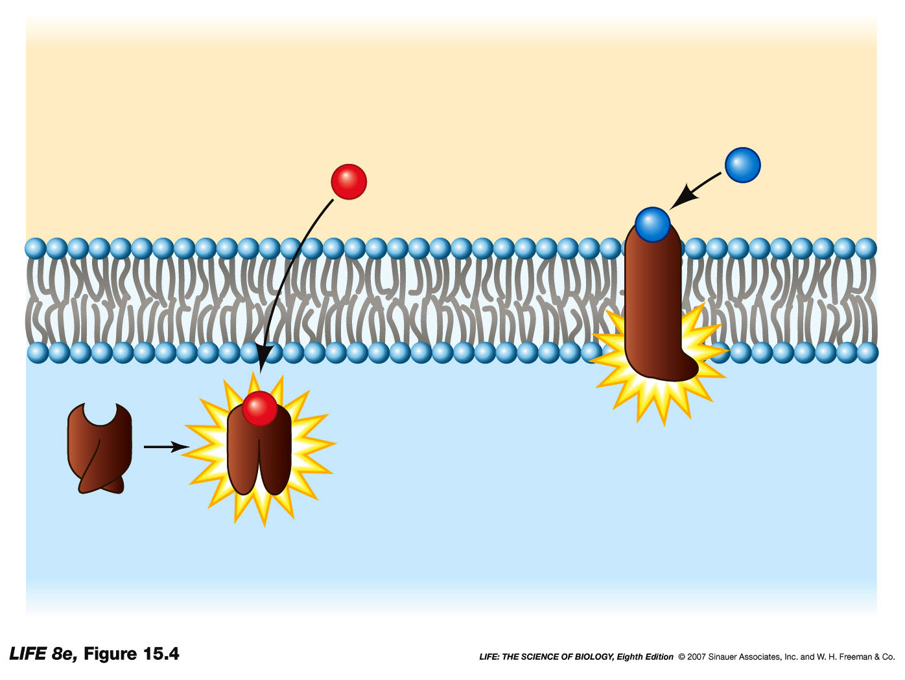
Intro to Biotech
Lect.16
Cell signaling/communication
2. Signaling:
paracrine
Signals??
a. External -
b. internal
• autocrine:
• paracrine:
• endocrine:
autocrine
endocrine
Receptors
• hormones
• Ion channels
• Kinases
• G protein linked

Slide 16
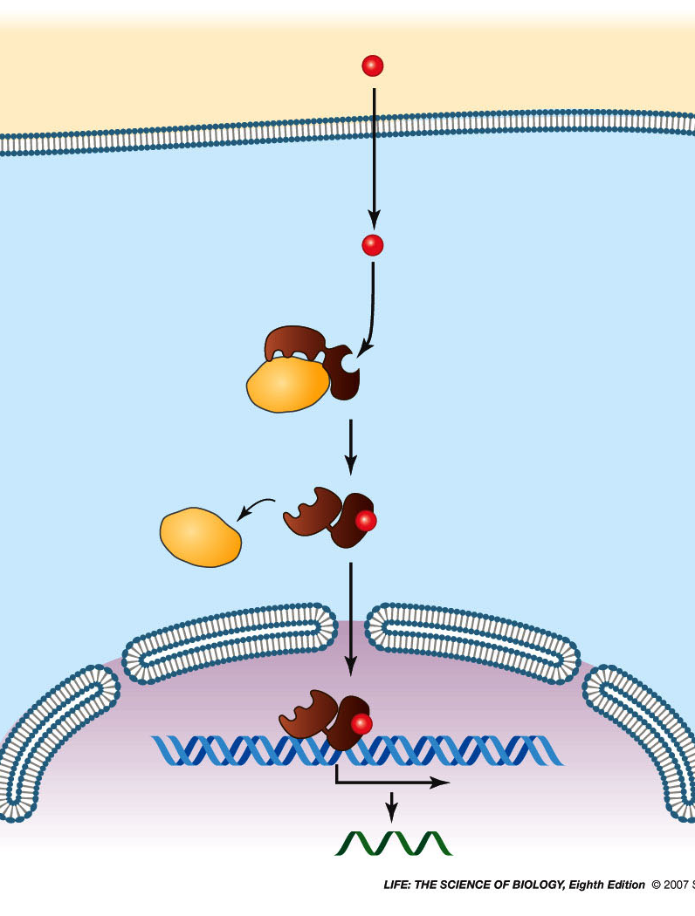
Intro to Biotech
Lect.16
Cell signaling/communication
Cytoplasmic receptors
Signal (cortisol)
Outside of cell
Inside of cell
Plasma
membrane
Cortisol
receptor
Chaperone
protein
DNA
Nucleus
Transcription
mRNA

Slide 17
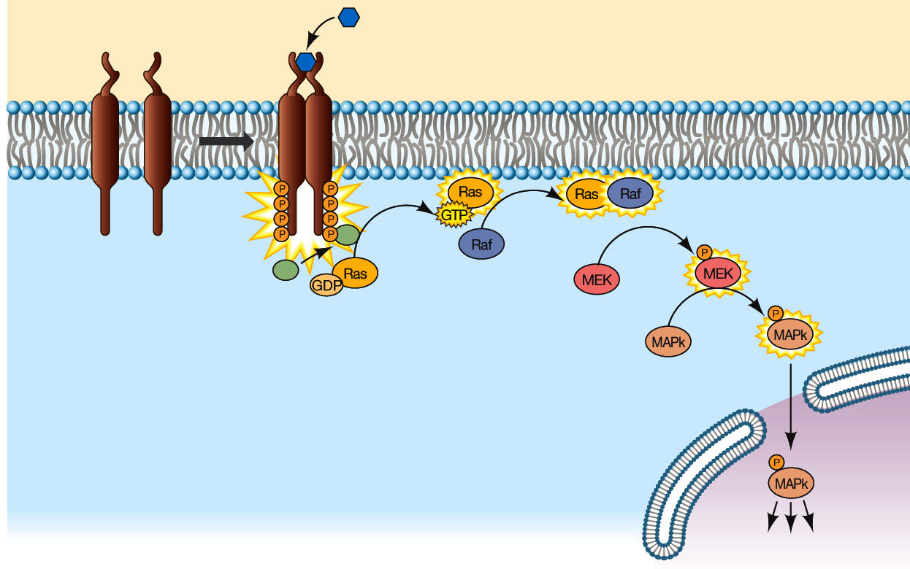
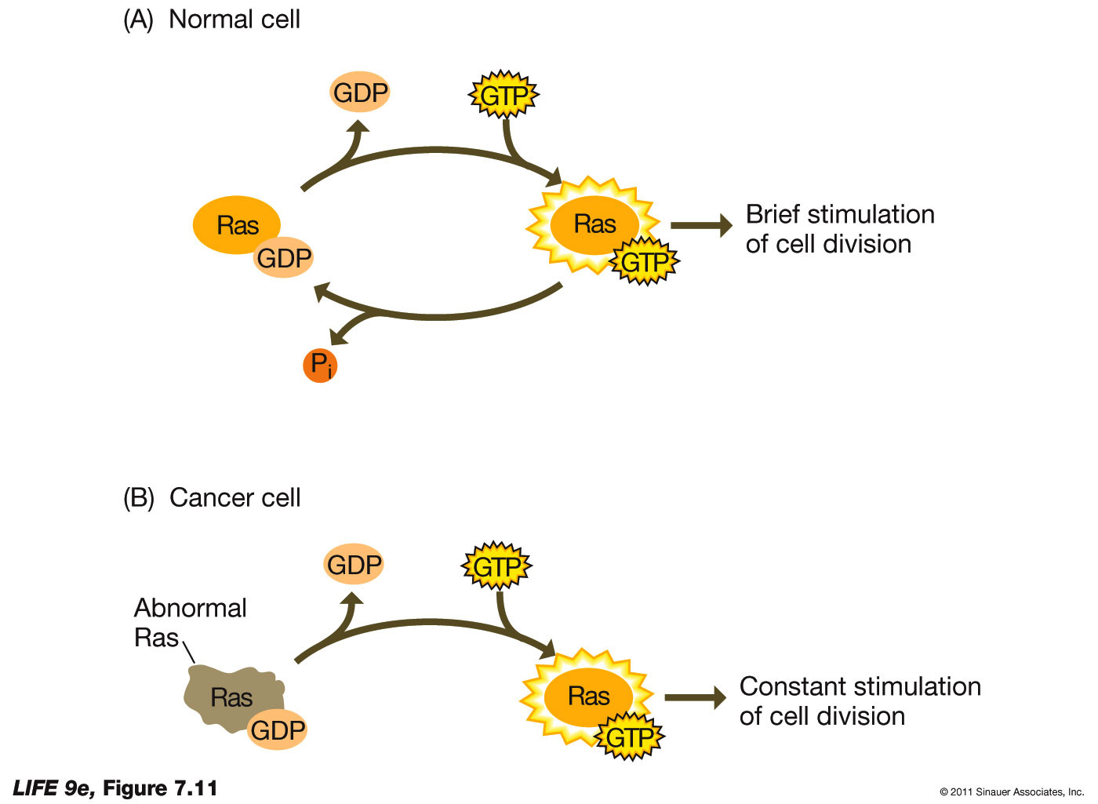
Intro to Biotech
Lect.16
Cell signaling/communication
Membrane receptors
• Kinases
- phosphorylation cascade
-
signal amplification
Growth factor
adaptor
Posttranslational Regulation

Slide 18
Intro to Biotech
Lect.16
Cell signaling/communication
Membrane receptors
KINASES & CANCER
Types of Oncogene mutations:
point mutations
Ras:
Types of Oncogene mutations: misregulation

Slide 19
Intro to Biotech
Lect.16
Cell signaling/communication
Membrane receptors
KINASES & CANCER
Types of Oncogene mutations: misregulation
Novel Gene Regulation
bcl2 on in B lymp.
Prevents apoptosis

